Slide 1

TEG Coding Challenge
2025

Slide 2
Instructions for The Coding Challenge

Slide 3
Instructions Requirements
You are asked to create a web application that shows:
A listing of all events taking place at a user selected venue.
A user should be able to change the venue and view all events at this venue.
When a user clicks on an event, the user should be shown various information fields about this event, at a minimum the name of the event, the date/time and location. Some events contain a description.
How you display the events is completely up to you. You may choose to implement a list/table view, a tile/card view, or a rich calendar view.
Consider the event source is not reliable all the time, provide an alternate approach to handle this scenario
Time: Please do not spend more than ~4 hours on this assignment.
If you are running short on time, please annotate your code with what you would code in and how you would code it in, as well as any considerations you might give to a specific problem.

Slide 4
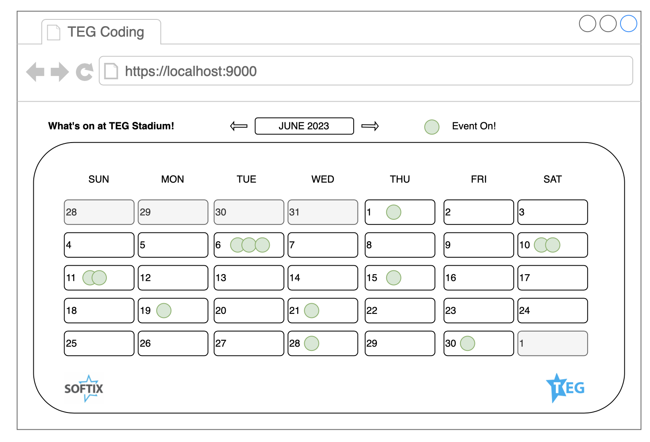
Calendar View Example

Slide 5



Architecture Systems
Web Browser
This application must be able to run in any modern web browser such as Edge, Chrome, Safari and Firefox.
Web App
A web application must be hosted on cloud and provide the relevant information
API
A data set available on https://teg-coding-challenge.s3.ap-southeast-2.amazonaws.com/events/event-data.json .

Slide 6
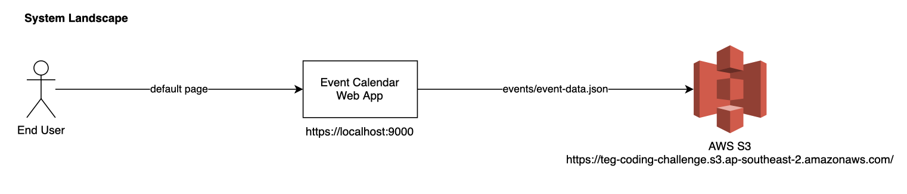
System Diagram
The following diagram depicts the dependencies between the systems.

Slide 7
API Specs Schema
The API is a basic JSON file hosted in a public AWS S3 bucket.
All data is purely fictional; any resemblance to real places, events or artists is purely coincidental.
The API endpoint is:
https://teg-coding-challenge.s3.ap-southeast-2.amazonaws.com/events/event-data.json
A schema description of the JSON response can be found here:
https://teg-coding-challenge.s3.ap-southeast-2.amazonaws.com/events/event-data.schema.json
Caution!
While the developers of the API have taken great care to ensure conformity to the schema, it is always good practice to employ defensive coding to cater for any oddballs ;)

Slide 8
Acceptance Criteria Technical
Please ensure adherence to the following technical acceptance criteria:
Use any UI framework of your choice
Hosted on cloud
Handled the outage in the source data (for example event json)
Is fully responsive and renders presentably on desktops, tablets and mobiles
Code is checked into a Git based repository (GitLab, GitHub, etc)
The Git repository contains a README.md file with instructions on how to work with it
Tip!
While the task is to build a presentable web app, this is a coding challenge. Good quality code is preferred over completion of the application.

Slide 9
Instructions for Submitting

Slide 10
Submitting Your Code
Once you are complete or have reached the allotted time:
Review the acceptance criteria; for anything that was missed, feel free to add comments with your submissions on why it was missed and how you would have implemented it.
Ensure the code is uploaded to a Git repository that can be accessed by TEG
Send the link for the Git repository alongside any comments you wish to submit to either your recruiter or your representative at TEG.
Tip!
Remember to have fun in coding this exercise and feel free to express your creative side if you wish!!

Slide 11
Code Away!
</challenge>

Slide 12


